Slide 1
UPPER SIXTH ARTS
GEOGRAPHY
Lesson 17
The Rank-Size Rule
Notes:
Good morning, class, and welcome to our geography lesson. I am your geography teacher, Mr Kamdem. Today we are starting Lesson 17: The Rank-Size Rule.

Slide 2
CLASS INFO
Class, Chapter and Duration
Class | Upper Sixth Arts
Chapter | Module 5: Understanding and managing settlement dynamics across the world in general and Cameroon in particular
Duration | 2 periods (2 × 50 minutes)
Notes:
This lesson is for Upper Sixth Arts. It belongs to Module 5: Understanding and managing settlement dynamics across the world in general and Cameroon in particular. We shall need 2 periods to cover it.

Slide 3
IDENTIFICATION
Lesson Identification
Topic | Urban Hierarchy
Sub-topic | Urban Hierarchy
Lesson | Lesson 17: The Rank-Size Rule
Notions / Concepts | Rank-size rule, primate city, binary pattern, steppe pattern.
Syllabus focus | Meaning and formula; applicability and reasons; deviations: primate, binary and steppe patterns with examples and reasons.
Competence | Learners are able to apply the rank-size rule and explain deviations from it.
Notes:
Our topic is Urban Hierarchy, and the sub-topic is Urban Hierarchy. The key notions we shall use today are: rank-size rule, primate city, binary pattern, steppe pattern. At the end, you should be able to do this: learners are able to apply the rank-size rule and explain deviations from it.

Slide 4

HOMEWORK CORRECTION
Correction of the Homework
Question (Lesson 16: Settlement Size and Functional Relationship):
Count the functions of two towns of different sizes and compare.
Notes:
Before we start the new lesson, let us correct the homework I gave you at the end of Lesson 16: Settlement Size and Functional Relationship. The question was: Count the functions of two towns of different sizes and compare. Take out your exercise books.

Slide 5
HOMEWORK CORRECTION
Correction: Possible Answer
Example: a village of 2,000 people has 5 functions (school, church, market, borehole, clinic); a town of 50,000 has more than 40 functions (banks, secondary schools, hospital, hotels).
Notes:
Here is a good answer. Example: a village of 2,000 people has 5 functions (school, church, market, borehole, clinic); a town of 50,000 has more than 40 functions (banks, secondary schools, hospital, hotels). Compare it with your own answer and correct your work in red.

Slide 6
LESSON PLAN
Lesson Plan
Correction of the homework
Objectives and recall
Real-life situation and action to take
Learning activities
Board summary
Evaluation, remediation and homework
Notes:
Here is the plan of our lesson today. First, we shall correct the homework. Then we shall look at the objectives and recall what you already know. After that, we shall study a situation from real life and the action to take, and do the learning activities. Finally, we shall copy the board summary, do the evaluation and the remediation, and I will give you the homework.

Slide 7
OBJECTIVES
Objectives
By the end of this lesson, you should be able to:
State the rank-size rule and its formula.
Apply it to a set of towns.
Explain primate, binary and steppe patterns.
Notes:
By the end of this lesson, you should be able to do three things. Number 1: state the rank-size rule and its formula. Number 2: apply it to a set of towns. Number 3: explain primate, binary and steppe patterns.

Slide 8
PREVIOUS KNOWLEDGE
Previous Knowledge
Towns form a hierarchy.
Douala and Yaoundé are Cameroon's biggest cities.
Notes:
Let us first remember what you already know. Towns form a hierarchy. Douala and Yaoundé are Cameroon's biggest cities. Keep this in mind, because we shall build on it today.

Slide 9
REAL-LIFE SITUATION
Situation in Real Life
In Senegal, Dakar is many times bigger than any other town. In Cameroon, Douala and Yaoundé are almost equal and much bigger than the rest. Learners ask what the "normal" pattern is.
Notes:
Listen carefully to this situation from real life. In Senegal, Dakar is many times bigger than any other town. In Cameroon, Douala and Yaoundé are almost equal and much bigger than the rest. Learners ask what the "normal" pattern is. Think about it, because I am going to ask you some questions.

Slide 10
REAL-LIFE SITUATION
Situation: Question 1
What is the problem in the situation?
Notes:
Question 1: What is the problem in the situation? Think for a moment, then raise your hand to answer.

Slide 11
REAL-LIFE SITUATION
Answer
Countries have different town size patterns.
Notes:
Good. Countries have different town size patterns.

Slide 12
REAL-LIFE SITUATION
Situation: Question 2
What rule describes the normal pattern?
Notes:
Question 2: What rule describes the normal pattern? Think for a moment, then raise your hand to answer.

Slide 13
REAL-LIFE SITUATION
Answer
The rank-size rule.
Notes:
Good. The rank-size rule.

Slide 14
REAL-LIFE SITUATION
Situation: Question 3
What is Cameroon's pattern called?
Notes:
Question 3: What is Cameroon's pattern called? Think for a moment, then raise your hand to answer.

Slide 15
REAL-LIFE SITUATION
Possible Answer
Binary.
Notes:
Good. Binary.

Slide 16
ACTION TO TAKE
Action to Take
Analyse the urban system of Cameroon with the rank-size rule.
Notes:
From this situation, the action we are working towards in this lesson is the following: analyse the urban system of Cameroon with the rank-size rule.

Slide 17
JUSTIFICATION
Justification of the Lesson
This lesson helps us to compare the urban systems of countries.
Notes:
Why is this lesson important for you? This lesson helps us to compare the urban systems of countries.

Slide 18
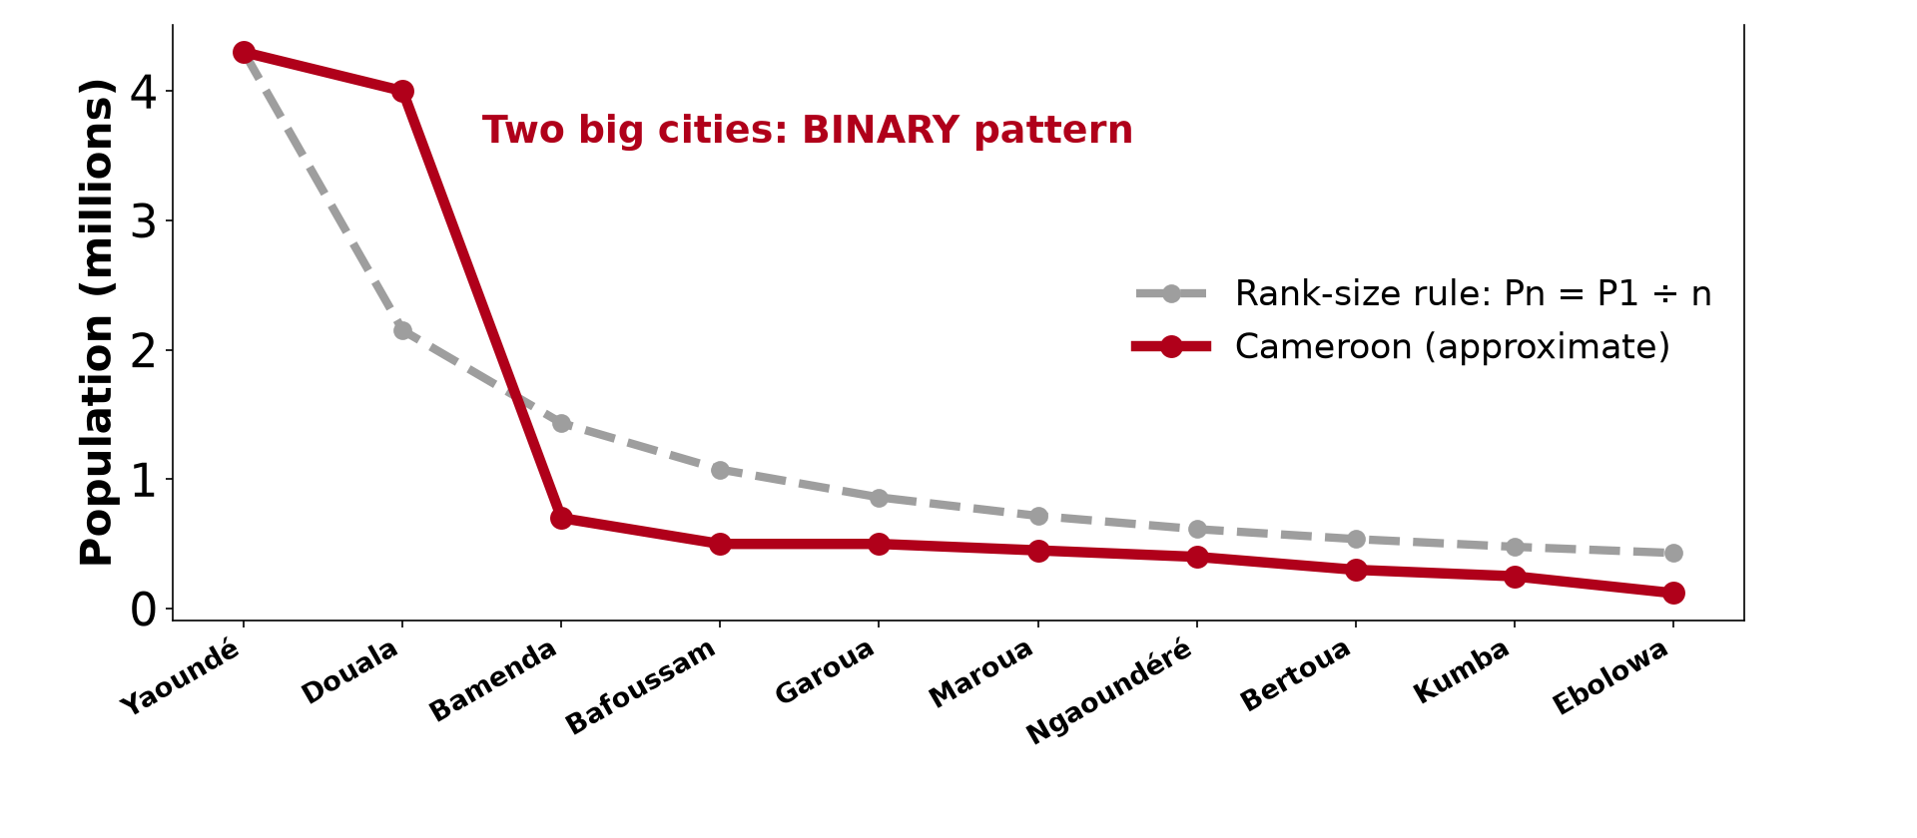
1. MEANING AND FORMULA
Activity 1
Rank-size rule and Cameroon (approximate).
Notes:
Activity 1. Look carefully at this diagram: rank-size rule and Cameroon (approximate). Observe every detail before I ask the question.

Slide 19
1. MEANING AND FORMULA
Activity 1: Question
According to the rule, how big should the 4th town be if the largest has 4 million?
Notes:
Here is the question for Activity 1: According to the rule, how big should the 4th town be if the largest has 4 million? Take one minute to think and write your answer in your rough notebook.

Slide 20
1. MEANING AND FORMULA
Activity 1: Answer
4 ÷ 4 = 1 million.
Notes:
Let us check the answer together. 4 ÷ 4 = 1 million.

Slide 21

2. APPLICABILITY
Activity 2
Main towns of Cameroon.
Notes:
Activity 2. Look carefully at this diagram: main towns of Cameroon. Observe every detail before I ask the question.

Slide 22
2. APPLICABILITY
Activity 2: Question
Does Cameroon follow the rank-size rule?
Notes:
Here is the question for Activity 2: Does Cameroon follow the rank-size rule? Take one minute to think and write your answer in your rough notebook.

Slide 23
2. APPLICABILITY
Activity 2: Answer
No, the two biggest cities are too large compared with the others.
Notes:
Let us check the answer together. No, the two biggest cities are too large compared with the others.

Slide 24
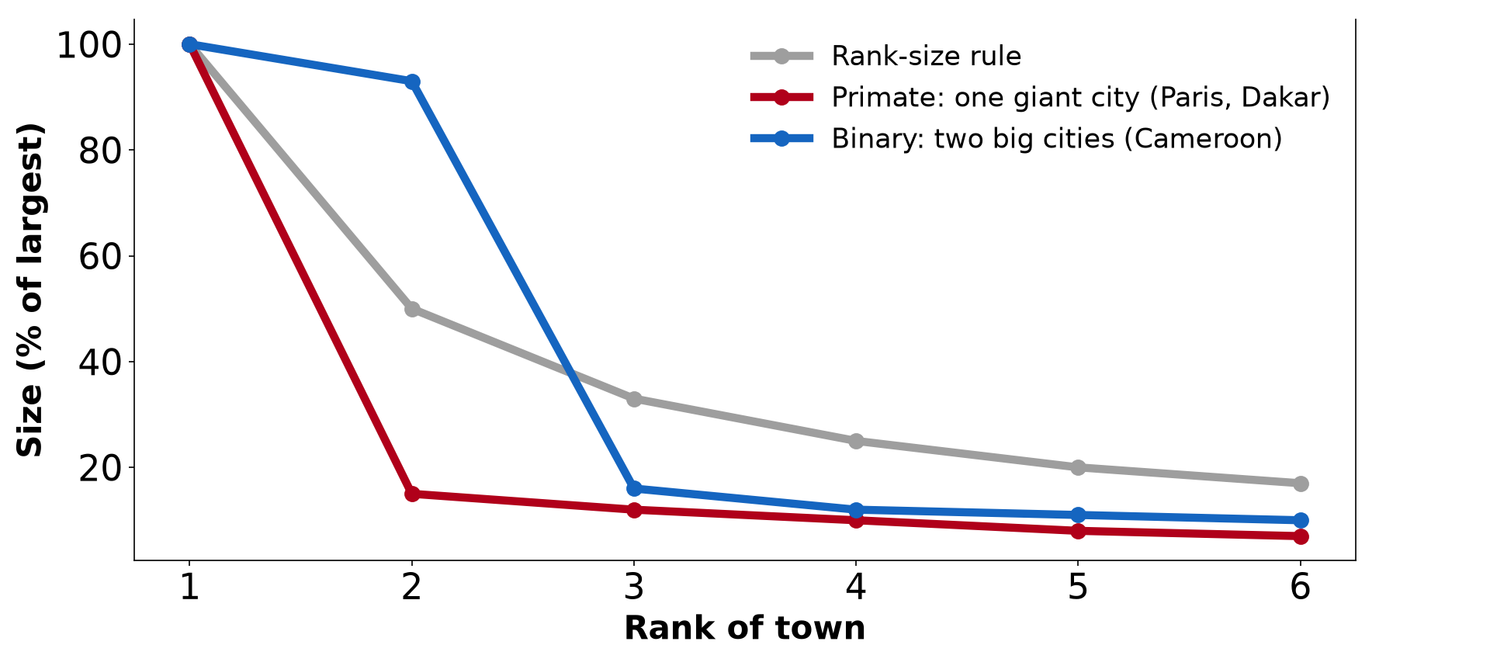
3. DEVIATIONS: PRIMATE
Activity 3
Rank-size, primate and binary patterns.
Notes:
Activity 3. Look carefully at this diagram: rank-size, primate and binary patterns. Observe every detail before I ask the question.

Slide 25
3. DEVIATIONS: PRIMATE
Activity 3: Question
What is a primate city?
Notes:
Here is the question for Activity 3: What is a primate city? Take one minute to think and write your answer in your rough notebook.

Slide 26
3. DEVIATIONS: PRIMATE
Activity 3: Answer
A city much larger than the second city, dominating the country.
Notes:
Let us check the answer together. A city much larger than the second city, dominating the country.

Slide 27

3. DEVIATIONS: BINARY
Activity 4
Douala, one of Cameroon's two big cities.
Notes:
Activity 4. Look carefully at this picture: douala, one of Cameroon's two big cities. Observe every detail before I ask the question.

Slide 28
3. DEVIATIONS: BINARY
Activity 4: Question
Why does Cameroon have a binary pattern?
Notes:
Here is the question for Activity 4: Why does Cameroon have a binary pattern? Take one minute to think and write your answer in your rough notebook.

Slide 29
3. DEVIATIONS: BINARY
Activity 4: Answer
Douala is the economic capital and Yaoundé the political capital.
Notes:
Let us check the answer together. Douala is the economic capital and Yaoundé the political capital.

Slide 30

3. REASONS
Activity 5
Yaoundé.
Notes:
Activity 5. Look carefully at this picture: yaoundé. Observe every detail before I ask the question.

Slide 31
3. REASONS
Activity 5: Question
Give two reasons for primate cities in LEDCs.
Notes:
Here is the question for Activity 5: Give two reasons for primate cities in LEDCs. Take one minute to think and write your answer in your rough notebook.

Slide 32
3. REASONS
Activity 5: Answer
Colonial history and concentration of government and industry in one city.
Notes:
Let us check the answer together. Colonial history and concentration of government and industry in one city.

Slide 33
BOARD SUMMARY
Board Summary
Topic: Urban Hierarchy
Sub-topic: Urban Hierarchy
Lesson 17: The Rank-Size Rule
Notes:
Now we are going to copy the board summary. Write the title and the headings neatly in your notebooks. I will give you enough time for each slide, so do not rush.

Slide 34
BOARD SUMMARY
1. Meaning and Formula of the Rank-Size Rule
The rank-size rule can be understood as follows:
Rank-size rule: It states that the population of a town of rank n equals the population of the largest town divided by n. The second town is half the first, the third one-third, and so on.
Notes:
Let us copy Meaning and Formula of the Rank-Size Rule. The rank-size rule can be understood as follows. On this slide we have Rank-size rule. Write each point on a new line, with the key term first, and explain it in your own words when we revise. When you finish, we go to the next slide.

Slide 35
BOARD SUMMARY
1. Meaning and Formula of the Rank-Size Rule (continued)
Formula: Pn = P1 ÷ n. If the largest town has 4 million people, the fourth should have 1 million.
Notes:
We continue with Meaning and Formula of the Rank-Size Rule. On this slide we have Formula. Write each point on a new line, with the key term first, and explain it in your own words when we revise.

Slide 36
BOARD SUMMARY
1. Meaning and Formula of the Rank-Size Rule
Illustration: the rank-size rule
Notes:
Now draw this illustration in your notebook: the rank-size rule. Give it a title and label it clearly.

Slide 37
BOARD SUMMARY
2. Applicability and Reasons
The rule applies in some countries:
Applicability: It fits large, developed countries with a long urban history and integrated economies, such as the USA. It is shown as a straight line on a log graph.
Notes:
Let us copy Applicability and Reasons. The rule applies in some countries. On this slide we have Applicability. Write each point on a new line, with the key term first, and explain it in your own words when we revise. When you finish, we go to the next slide.

Slide 38
BOARD SUMMARY
2. Applicability and Reasons (continued)
Reasons: A balanced hierarchy develops where economic activities are spread across the country. Many regional centres compete.
Notes:
We continue with Applicability and Reasons. On this slide we have Reasons. Write each point on a new line, with the key term first, and explain it in your own words when we revise.

Slide 39
BOARD SUMMARY
3. Deviations from the Rule
The main deviations are:
Primate pattern: The largest city is much bigger than the second, like Paris, Lagos (formerly) or Bangkok. It results from colonial history, centralisation of power and investment.
Notes:
Let us copy Deviations from the Rule. The main deviations are. On this slide we have Primate pattern. Write each point on a new line, with the key term first, and explain it in your own words when we revise. When you finish, we go to the next slide.

Slide 40
BOARD SUMMARY
3. Deviations from the Rule (continued)
Binary pattern: Two cities of almost equal size dominate the country. Cameroon has a binary pattern with Douala (economic capital) and Yaoundé (political capital).
Notes:
We continue with Deviations from the Rule. On this slide we have Binary pattern. Write each point on a new line, with the key term first, and explain it in your own words when we revise. When you finish, we go to the next slide.

Slide 41
BOARD SUMMARY
3. Deviations from the Rule (continued)
Stepped pattern: Several towns of similar size form steps in the hierarchy. It is found in federal or regionally balanced countries.
Notes:
We continue with Deviations from the Rule. On this slide we have Stepped pattern. Write each point on a new line, with the key term first, and explain it in your own words when we revise.

Slide 42
BOARD SUMMARY
3. Deviations from the Rule
Illustration: deviations from the rule
Notes:
Now draw this illustration in your notebook: deviations from the rule. Give it a title and label it clearly.

Slide 43
FORMATIVE EVALUATION
Evaluation 1
State the rank-size rule.
Notes:
Now let us check what you have understood. Question 1: State the rank-size rule. Answer in your exercise book.

Slide 44
FORMATIVE EVALUATION
Expected Answer
The town of rank n has 1/n of the population of the largest town.
Notes:
The expected answer is: the town of rank n has 1/n of the population of the largest town. If you got it right, well done.

Slide 45
FORMATIVE EVALUATION
Evaluation 2
Why is Cameroon's urban pattern binary?
Notes:
Now let us check what you have understood. Question 2: Why is Cameroon's urban pattern binary? Answer in your exercise book.

Slide 46
FORMATIVE EVALUATION
Expected Answer
Douala (economic capital) and Yaoundé (political capital) are both much larger than other towns.
Notes:
The expected answer is: douala (economic capital) and Yaoundé (political capital) are both much larger than other towns. If you got it right, well done.

Slide 47
REMEDIATION
Remediation
Fill in the blanks:
Pn = P1 ÷ ______.
A city far larger than the rest is a ______ city.
Cameroon has a ______ pattern.
Notes:
For those who need more practice, fill in the blanks in your exercise book. The answers are: number 1, n; number 2, primate; number 3, binary.

Slide 48
HOMEWORK
Homework
Using the populations of 8 Cameroonian towns, draw a rank-size graph.
Notes:
For your homework: Using the populations of 8 Cameroonian towns, draw a rank-size graph. We shall correct it at the beginning of our next lesson.

Slide 49
NEXT LESSON
Next Lesson
Our next lesson will be on:
Lesson 18: Structure of the City in MEDCs
Notes:
Our next lesson will be on Lesson 18: Structure of the City in MEDCs. Thank you for your attention, and see you next time.

Slide 50
BILINGUAL GAME
Bilingual Game (Jeu Bilingue)
English | Français
Rank | Le rang
Primate city | La ville primatiale
Binary | Bicéphale
Rule | La règle
Deviation | L'écart
Capital | La capitale
Notes:
Let us play the bilingual game. I say a word in English, and you give me the French word. Then we do the reverse.

Slide 51
LOGBOOK
Official Logbook (1/2)
Module / Topic | Urban Hierarchy
Lesson Title | Lesson 17: The Rank-Size Rule
Expected Learning Outcomes | State the rank-size rule and its formula. Apply it to a set of towns. Explain primate, binary and steppe patterns.
Competence | Learners are able to apply the rank-size rule and explain deviations from it.
Notes:
I record this information in the official logbook of the class after the lesson.

Slide 52
LOGBOOK
Official Logbook (2/2)
Matter Taught | Meaning and Formula of the Rank-Size Rule; Applicability and Reasons; Deviations from the Rule.
Evaluation | Formative evaluation and remediation exercise.
Homework | Using the populations of 8 Cameroonian towns, draw a rank-size graph.
Enrolment / Present / Absent | ____ / ____ / ____
Achievement | To be completed after the lesson.
Notes:
I complete the second page of the logbook: the matter taught, the evaluation, the homework and the attendance.

Slide 53
TEACHER'S NOTE
Teacher's Note
Timing: Homework correction, plan, objectives 8 min | Recall, situation, action 10 min | 5 activities 30 min | Board summary (copying) 30 min | Evaluation, remediation 10 min | Homework, next lesson 5 min | Logbook 7 min
Without the projector (Activity 1): calculate for other ranks.
Without the projector (Activity 2): compare expected and real sizes.
Without the projector (Activity 3): give examples.
Without the projector (Activity 4): discuss the two cities.
Without the projector (Activity 5): list reasons.
Notes:
This slide is for me, the teacher: it gives the timing of the lesson and what to do if the projector is not available.

Slide 54
REFERENCES
References
National Geography Syllabus, MINESEC/IGE/IP-SS, 2019 — Module 5 (Settlement Geography).
Photo, Activity 4: “Douala” by christing-O-, CC BY 2.0, via Flickr (https://www.flickr.com/photos/76187282@N00/7227535754)
Photo, Activity 5: “Yaoundé” by wili_hybrid, CC BY-NC 2.0, via Flickr (https://www.flickr.com/photos/62223880@N00/5677034246)
Diagrams and animations: drawn for this lesson (Geography Department).
Notes:
These are the references and picture credits used to prepare this lesson.

